Slide 1
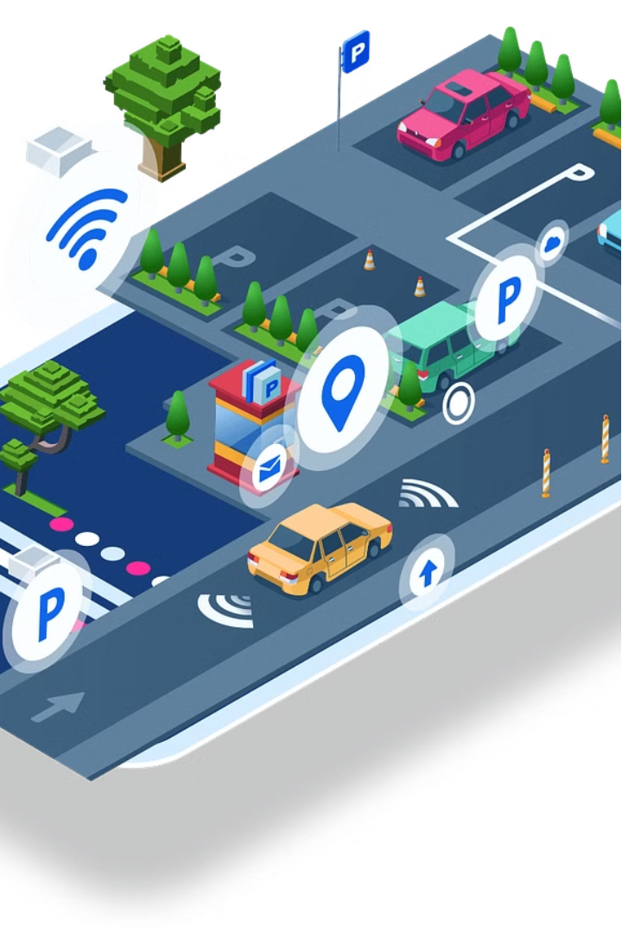

Smart Car Parking System
Abhishek Dhaka 12208085

Slide 2
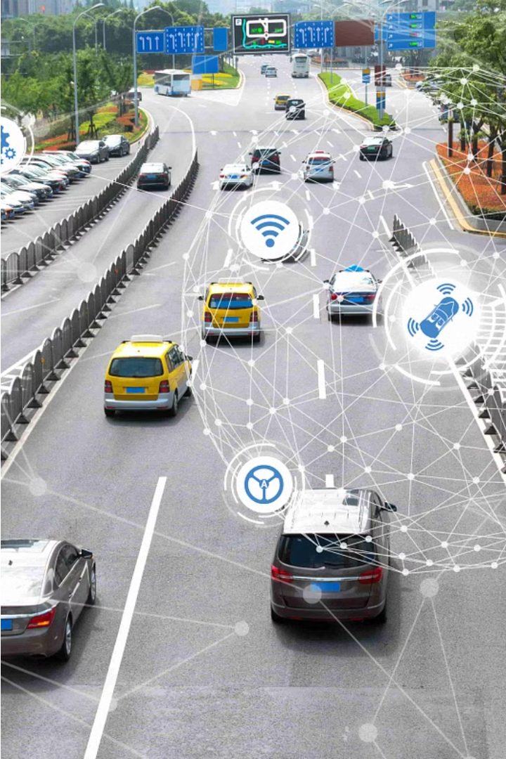
Introduction
Revolutionizing the way, we manage parking with an innovative IoT-based solution. This cutting-edge system employs advanced sensors, real-time data processing, and seamless automation to transform the parking experience for both drivers and facility operators.

Slide 3
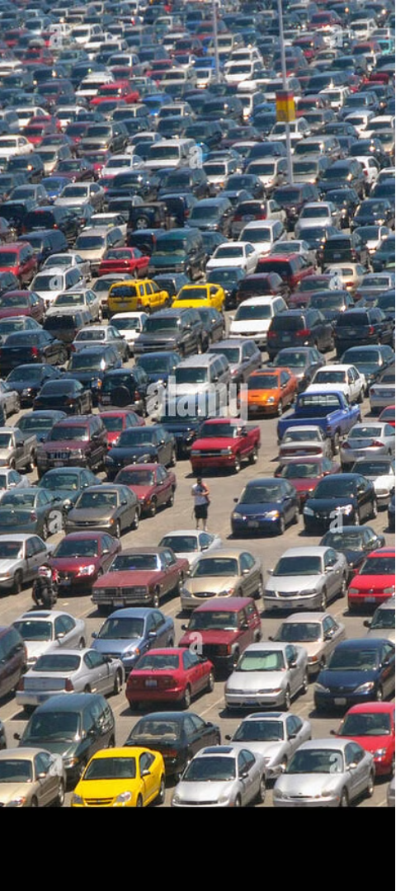
Problem Statement
Traditional parking systems often fall short in providing drivers with accurate, up-to-date information on available spaces, leading to frustration and inefficiency. Wasted time for both drivers and parking lot operators. The Smart Car Parking System aims to tackle these challenges by leveraging the power of IoT (Internet of Things) technology.

Slide 4



Problem Statement Cont..
Inefficient Space Utilization
Without real-time data, parking facilities struggle to optimize space allocation, leading to underutilized spaces and increased congestion.
Lack of Visibility
Drivers often face the frustration of searching for available spaces, especially in unfamiliar cities, wasting valuable time and resources.
Manual Operations
Reliance on manual ticketing and space management can result in human errors and delays, further exacerbating the parking experience.

Slide 5
System Overview
The Smart Car Parking System employs a comprehensive set of hardware and software components to create a seamless and efficient parking management solution. By integrating IR sensors, servo motors, an LCD display, and a ESP 32, the system continuously monitors parking space availability, controls access, and provides real-time information to drivers.
Hardware Components
- IR Sensors: Detect the presence of vehicles in parking spaces
- Servo Motor: Controls the barrier to open and close parking spaces
- LCD Display: Displays real-time parking availability and other relevant information
- ESP 32: Acts as the central processing unit, receiving data from sensors and controlling output devices

Slide 6
Software Integration
-The machine library is a built-in library in Python that allows us to control the GPIO pins on the ESP 32
-The smbus library is used to enable the I2C protocol with our ESP 32
- ESP 32 programming: Collects data from IR sensors, processes it, and sends commands to the servo motor and LCD display
- ThingSpeak integration: Utilizes the ThingSpeak platform for real-time data visualization and storage

Slide 7
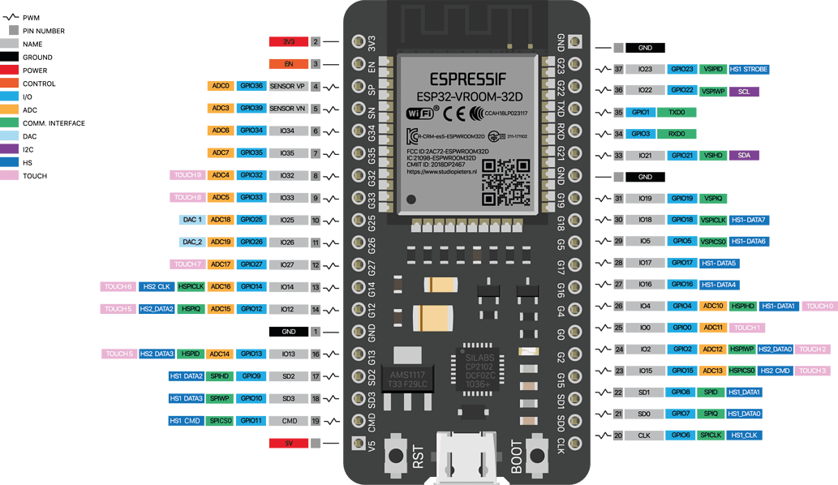
ESP 32
ESP32 is a low-cost, low-power System on Chip (SoC) microcontroller developed by Espressif Systems
It comes in both single-core and dual-core variations of the Tensilica’s 32-bit Xtensa LX6 Microprocessor.
It has integrated Wi-Fi and Bluetooth capabilities.
It is manufactured using TSMC’s ultra-low-power 40 nm technology.
It has a larger number of General Purpose Input/Output (GPIO) pins compared to the ESP8266.
It also includes touch-sensitive pins, a built-in Hall effect sensor, high-resolution ADCs, DAC, Serial Connectivity, and many other features

Slide 8
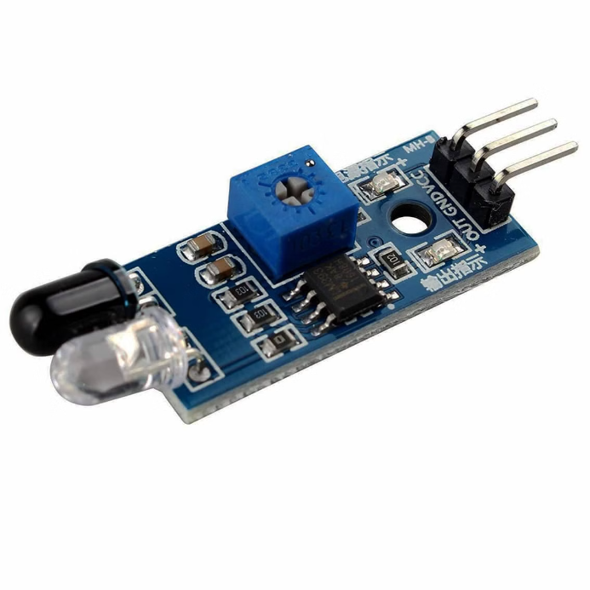
infrared Sensor
•The IR LED emits infrared light, invisible to the human eye.
•When the infrared light hits an object, it is reflected back and falls on the photodiode.
•The incident infrared light on the photodiode changes its resistance and output voltage.
•The altered output voltage can then be processed and analyzed to detect the presence or absence of the object.

Slide 9
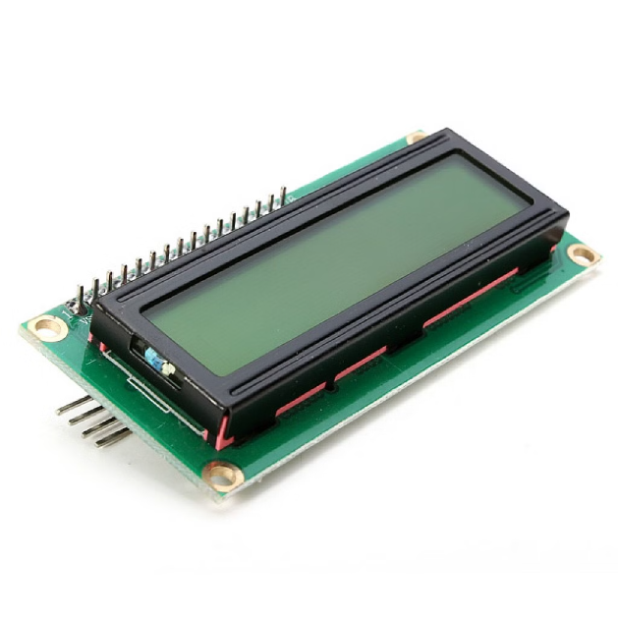
LCD Display
•Power Supply: The LCD receives power from the ESP 32’s GPIO pins.
•Initialization: Specific commands are sent from the ESP 32 to the LCD for setup.
•Data Transmission: Text or commands are sent to the LCD via GPIO pins.
•Refresh Rate: The display is refreshed several times per second by the ESP 32.

Slide 10
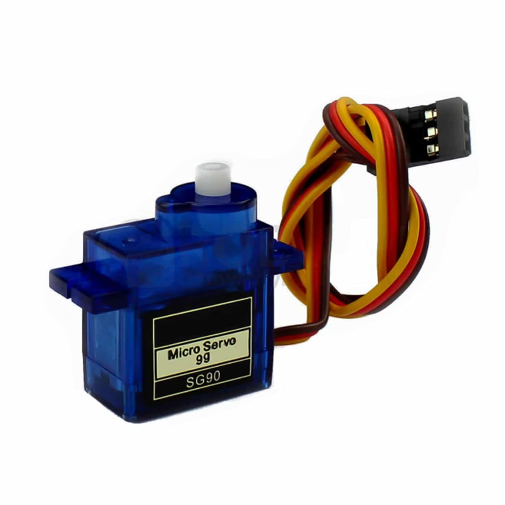
Servo Motor
•Connection: Attach servo motor to ESP 32 GPIO pins.
•PWM Control: Use Python for Pulse Width Modulation to set servo position.
•Duty Cycle: Modify duty cycle in the script to change the servo angle.
•External Power: Use a separate power supply for the servo, if needed.
•Scripting: Write a Python script to manage the servo’s movements.

Slide 11




Methodology
The Smart Car Parking System operates seamlessly, providing drivers with up-to-the-minute information on parking space availability and optimizing the utilization of the parking facility. The system's flow of operation is as follows:
Sensor Detection
Data Processing
Space Allocation
Information Display
IR sensors continuously monitor the parking spaces, detecting the presence or absence of vehicles.
The ESP 32 collects and processes the sensor data, updating the real-time availability information.
The system controls the servo motors to open or close the barriers, managing the available parking spaces.
The LCD display presents the real-time parking space availability to drivers, guiding them to the nearest open spot.

Slide 12

Results
The implementation of the Smart Car Parking System delivers tangible benefits to both drivers and parking facility operators, enhancing the overall parking experience.
Real-time Updates
Optimized Utilization
Streamlined Operations
Drivers can access real-time information on parking space availability, reducing the time and frustration spent searching for a spot.
The system's automated space management ensures optimal utilization of the parking facility, minimizing congestion and improving efficiency.
Parking lot operators benefit from reduced manual labor, enhanced data-driven decision-making, and improved customer satisfaction.

Slide 13




Future Scope
The Smart Car Parking System is designed to be versatile and adaptable, allowing for seamless integration with emerging technologies and future advancements.
Mobile Integration
Machine Learning
City-wide Integration
Integrating the system with mobile applications can enable remote parking space reservation, allowing drivers to secure a spot before arriving at the facility.
Implementing machine learning algorithms can enhance the system's predictive capabilities, forecasting parking space availability based on historical data and user patterns.
Expanding the system to larger parking facilities and integrating it with city-wide traffic management systems can create a comprehensive smart city infrastructure.

Slide 14
Scalable and Adaptable Design
The Smart Car Parking System is designed with scalability and adaptability in mind, making it suitable for a wide range of parking facilities, from small lots to large-scale urban areas.
Scalable Architecture
Adaptable Integration
The modular design of the system allows for easy expansion to accommodate growing parking needs, with the ability to add more sensors, barriers, and display units as required.
The system's open architecture enables seamless integration with various third-party platforms and systems, such as parking management software, mobile apps, and city-wide traffic control systems.
The ESP 32-based central processing unit can handle the increased data flow and control requirements of larger parking facilities, ensuring seamless operation at scale.
This flexibility ensures that the Smart Car Parking System can be tailored to the unique requirements of different parking facilities, providing a customized solution for each client.

Slide 15
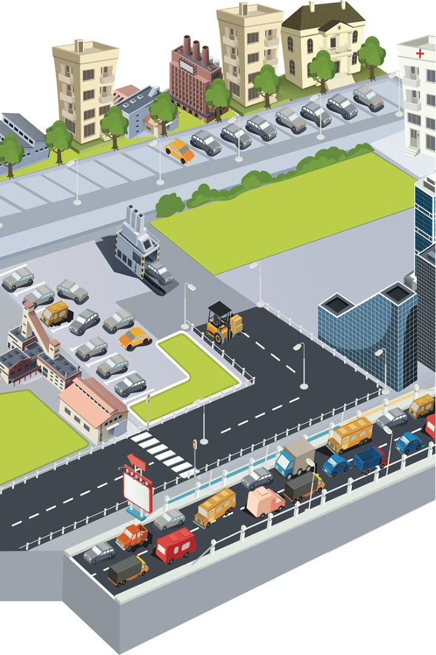
Conclusion
The Smart Car Parking System offers a comprehensive solution to the challenges faced by traditional parking systems. By leveraging the power of IoT technology, this innovative system enhances the parking experience for both drivers and facility operators, leading to increased efficiency, reduced congestion, and improved customer satisfaction.
With its real-time monitoring, automated space management, and seamless data integration capabilities, the Smart Car Parking System sets a new standard in parking management. As cities and communities continue to evolve, this scalable and adaptable solution is poised to play a crucial role in the development of smart city infrastructure, paving the way for a more efficient and sustainable future.

